Slide 1

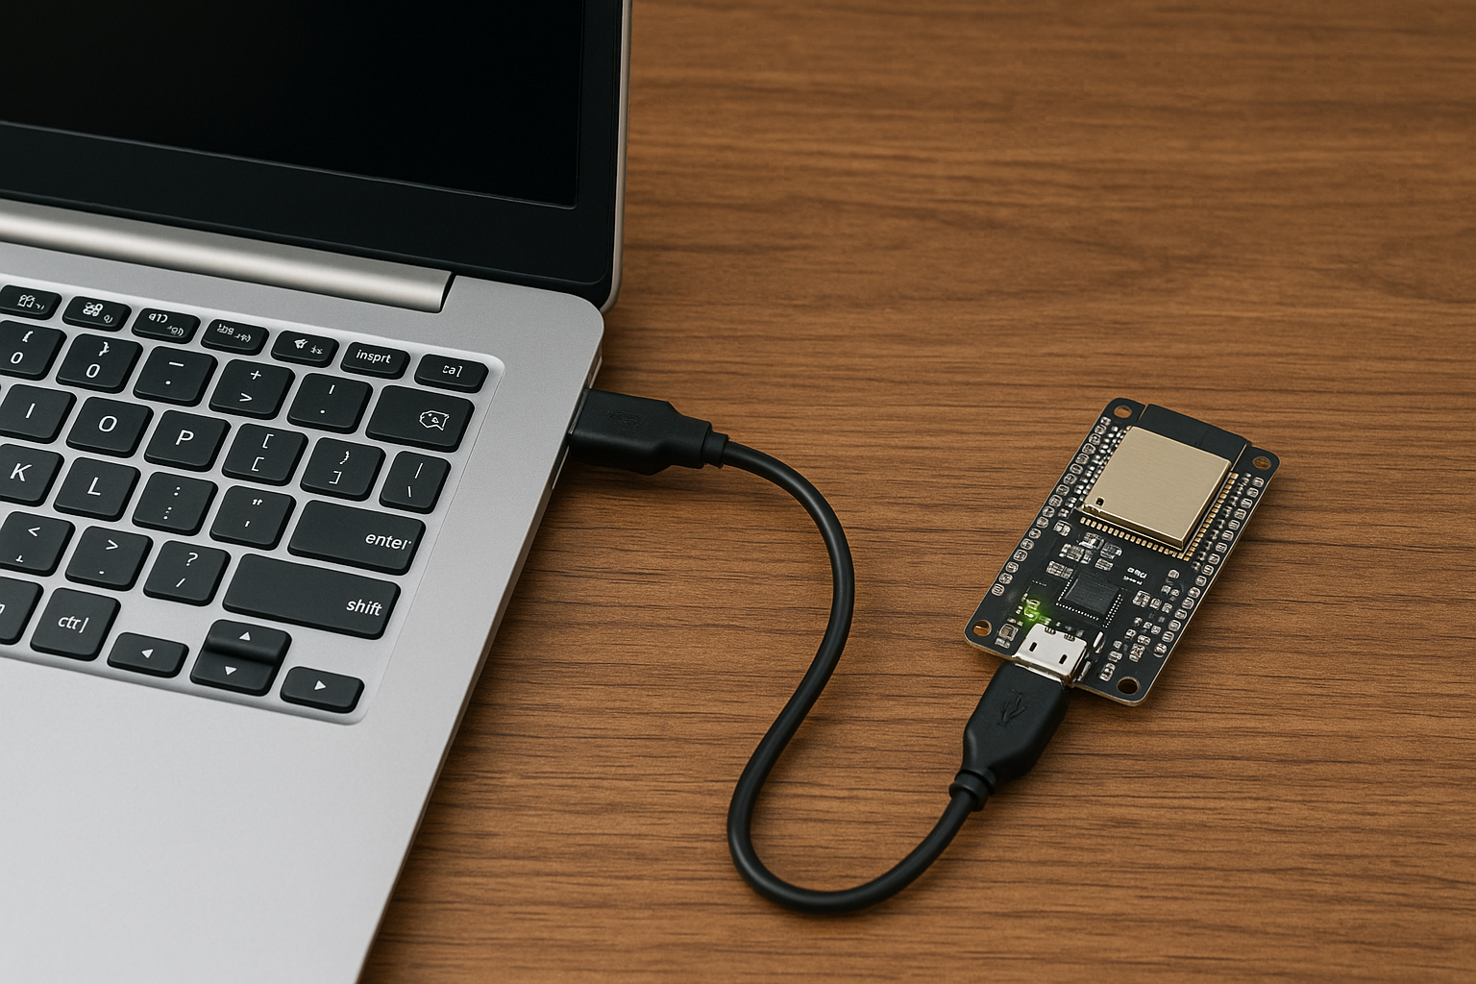
Name: Shobhit Sharma, BSc student Project type: laboratory project (önlab) Topic: Secure automotive software update using cryptography
Supervisors: Professor Dávid Sik
Description:
This ESP32-based project enables secure automotive software updates using RSA and AES cryptography.
The ESP32 receives a UART data containing an AES key (RSA encrypted), IV, and AES-encrypted message + signature (payload).
It decrypts the AES key using its private RSA key, then decrypts the payload.
The decrypted message contains a new status string and its RSA-SHA256 signature.
If signature verification passes using the sender’s public key, the ESP32 updates its internal message.
Otherwise, the payload is rejected.
A Python script prepares and transmits the final message securely.

Slide 2
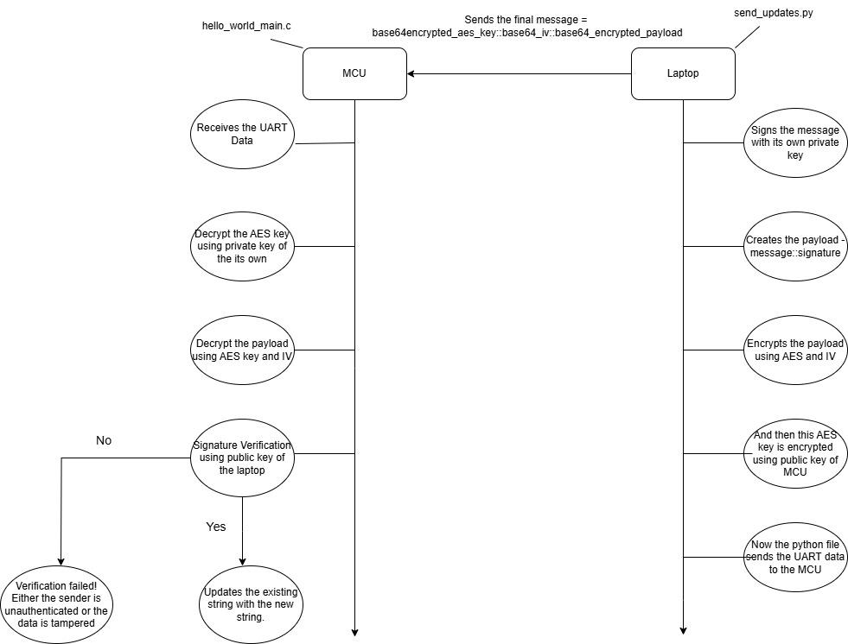
Hybrid Encryption for Secure Updates using RSA and AES
HERE IS THE FLOWCHART DEPICTING THE PROCESS!

Slide 3
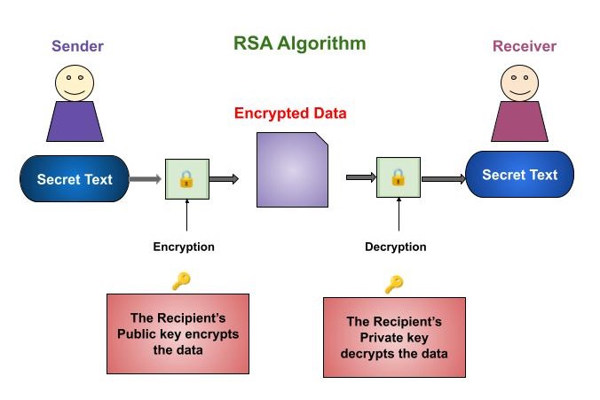
Hybrid Encryption for Secure Updates using RSA and AES
Description:
Laptop Side:-
Signs message with RSA private key (SHA-256).
Encrypts message using AES-256-CBC.
Encrypts AES key with ESP32's RSA public key.
Sends <enc_key>::<iv>::<payload> over UART.
ESP32 Side:-
Decrypts AES key using RSA private key.
Decrypts payload using AES-256-CBC.
Verifies signature with Laptop’s RSA public key.
Updates message only if valid.
Hybrid encryption used for secure message transfer:-
AES encrypts the payload (symmetric, for fast, secure data)
RSA encrypts the AES key (asymmetric, for key exchange).

Slide 4
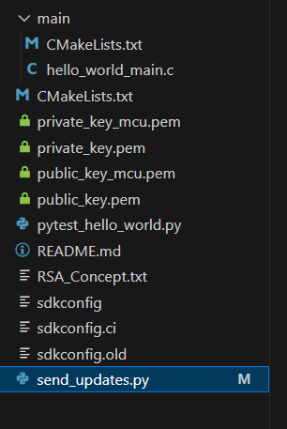
Project File Overview
Description:
secure_updates.py:-
Runs on the laptop side.
Signs message using RSA private key.
Encrypts message with AES, then encrypts AES key using RSA public key.
Sends the final Base64-encoded package over UART.
hello_world_main.c:-
Parses the received payload.
Decrypts AES key using RSA private key.
Decrypts message using AES-CBC.
Verifies the digital signature using laptop’s RSA public key and updates the string if verification passes
2 RSA Key Pairs used:
L: Signs messages (private key), shares public key with ESP32.
E: Decrypts AES key (private key), laptop encrypts with its public key.

Slide 5
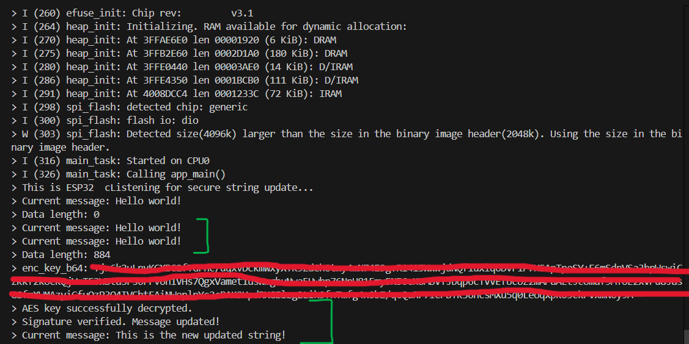
Results & future work
Results:
Secure UART transmission using hybrid encryption (RSA + AES) was successfully implemented.
The ESP32 verifies the authenticity of incoming messages and updates only if valid.
Manual tampering or invalid signatures are correctly rejected, ensuring integrity.
Base64 parsing, RSA decryption, and AES payload handling work efficiently on constrained hardware.
UART communication remains stable even with large, encrypted payloads.
Future work: Extending the system to perform full firmware updates instead of just updating a string. The current UART-based transmission can be enhanced to support secure Over-The-Air (OTA) updates. This would make the update mechanism more practical and scalable in real-world automotive scenarios.

